Slide 1
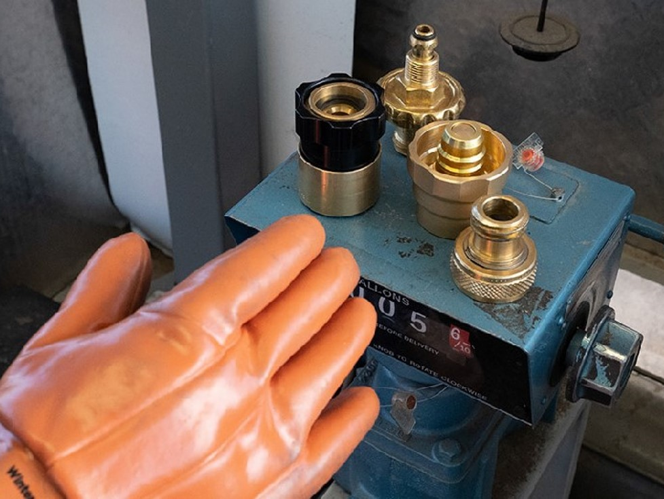
Drag and drop to insert full screen image into the background.
DISPENSING PROPANE SAFELY
Post Filling Cylinders
Notes:
Place narration script for slide here

Slide 2
Method determined at the local level
Federal + NFPA 58:

Slide 3
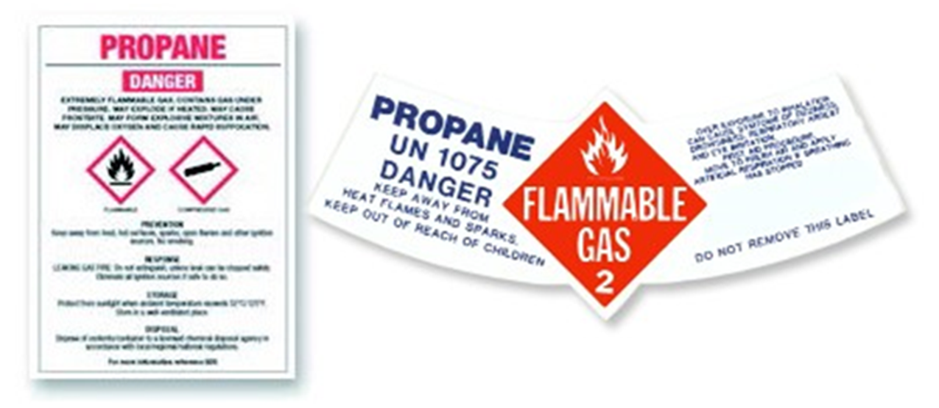
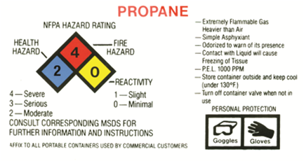
Post-Filling Procedures

Slide 4
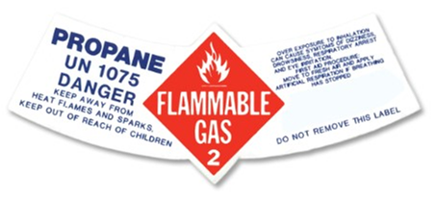
Shipping Label

Slide 5
Method determined at the local level

Slide 6
Consumer Information Warning Labels

Slide 8
Method determined at the local level

Slide 9
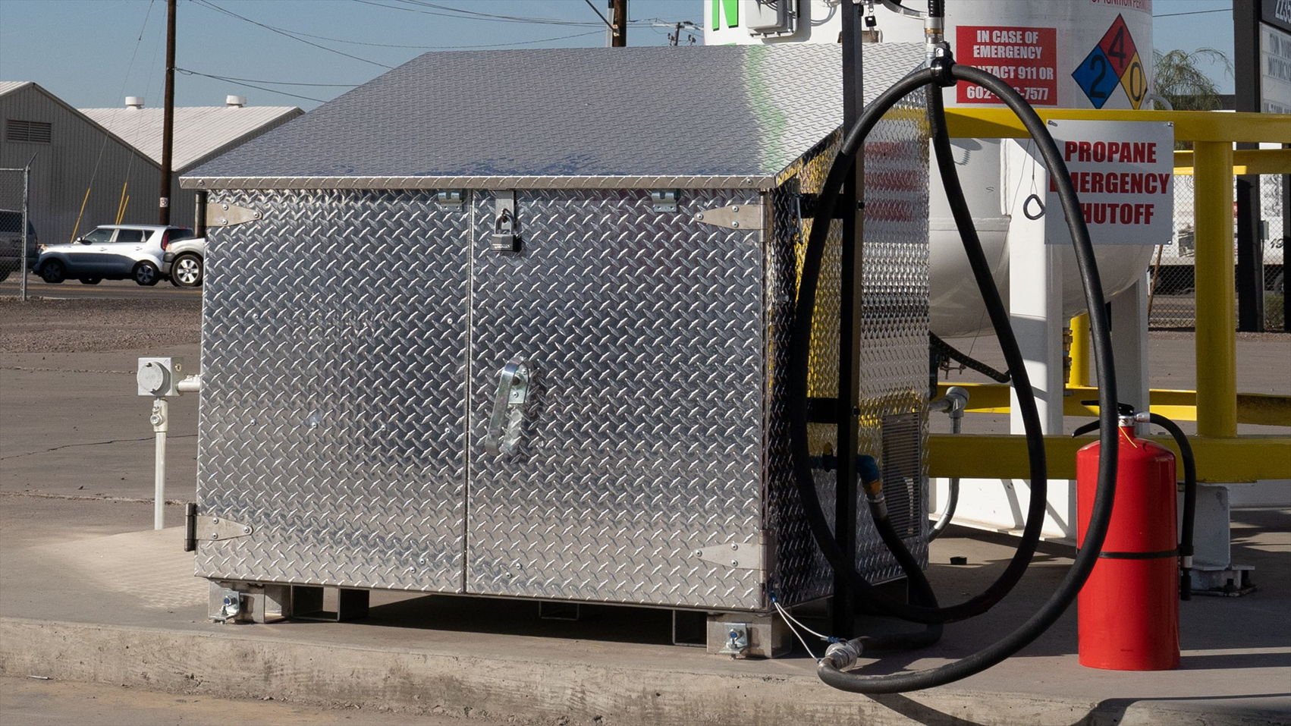
Shutting Down a Dispenser

Slide 10
Method determined at the local level

Slide 11
Check Understanding

Slide 12
If a cylinder warning label is not legible or if the paper or plastic sleeve is removed during inspection, before releasing the cylinder to the customer, ___________.
place a new cylinder warning label on it.
have the customer sign a waiver.
orally deliver safety information.
contact the supervisor.
Notes:
If a cylinder warning label is not legible or if the paper or plastic sleeve is removed during inspection, before releasing the cylinder to the customer, ___________.
place a new cylinder warning label on it.
have the customer sign a waiver.
orally deliver safety information.
contact the supervisor.
Correct answer: place a new cylinder warning label on it.

Slide 13
If a cylinder warning label is not legible or if the paper or plastic sleeve is removed during inspection, before releasing the cylinder to the customer, ___________.
place a new cylinder warning label on it.
have the customer sign a waiver.
orally deliver safety information.
contact the supervisor.
Notes:
If a cylinder warning label is not legible or if the paper or plastic sleeve is removed during inspection, before releasing the cylinder to the customer, ___________.
place a new cylinder warning label on it.
have the customer sign a waiver.
orally deliver safety information.
contact the supervisor.
Correct answer: place a new cylinder warning label on it.

Slide 14
Consumer information/warning labels must be on all portable refillable cylinders not filled on site and with _________ pounds propane capacity or less.
20
33
45
100
Notes:
Consumer information/warning labels must be on all portable refillable cylinders not filled on site and with _________ pounds propane capacity or less.
20
33
45
100
Correct answer: 100

Slide 15
Consumer information/warning labels must be on all portable refillable cylinders not filled on site and with _________ pounds propane capacity or less.
20
33
45
100
Notes:
Consumer information/warning labels must be on all portable refillable cylinders not filled on site and with _________ pounds propane capacity or less.
20
33
45
100
Correct answer: 100

Slide 16
Regulations require that cylinders be labeled clearly with _________ .
total filled weight
shipping name and hazard class
personal protection equipment (PPE) requirements
no smoking warning
Notes:
Regulations require that cylinders be labeled clearly with ________.
total filled weight
shipping name and hazard class
personal protection equipment (PPE) requirements
no smoking warning
Correct answer: shipping name and hazard class

Slide 17
Regulations require that cylinders be labeled clearly with _________ .
total filled weight
shipping name and hazard class
personal protection equipment (PPE) requirements
no smoking warning
Notes:
Regulations require that cylinders be labeled clearly with ________.
total filled weight
shipping name and hazard class
personal protection equipment (PPE) requirements
no smoking warning
Correct answer: shipping name and hazard class

Slide 18
Replace any old closing slide (with PERC or ELDT logos) with this slide.

